Slide 1
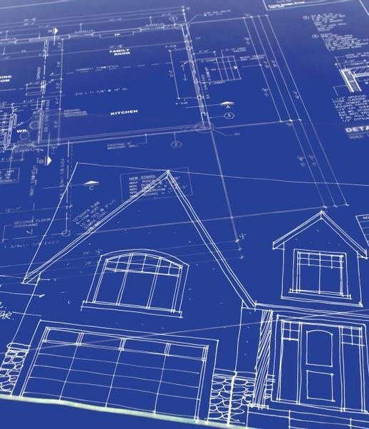
Smart Home
Mechatronics project

Slide 2
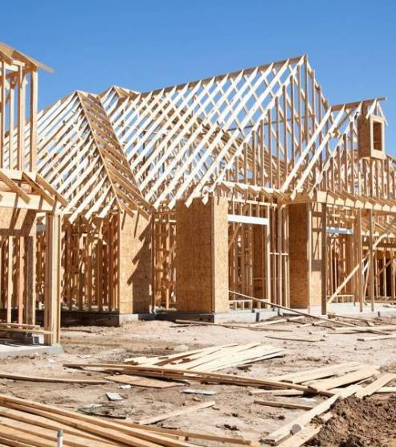
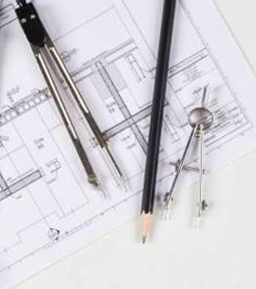
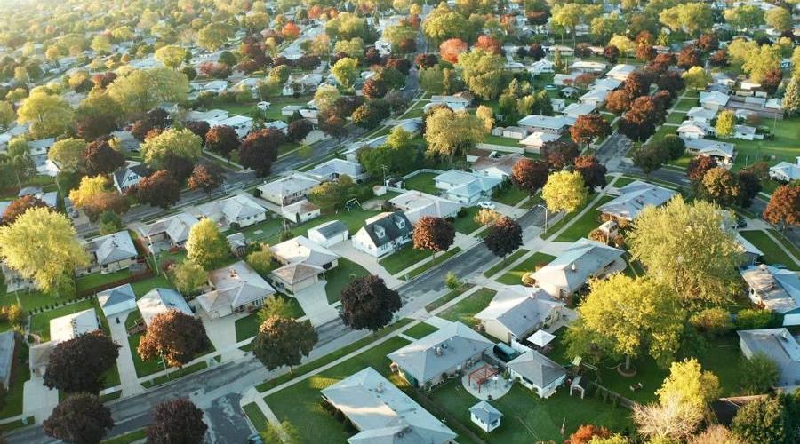
Agenda
Why smart home?!
Project idea
The Cost
Project hardware and software

Slide 3
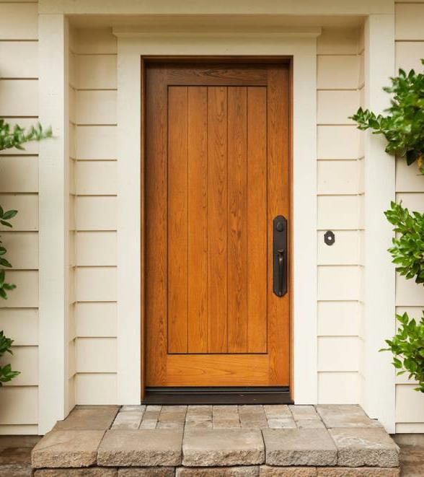
Introduction
Why smart home?!

Slide 4
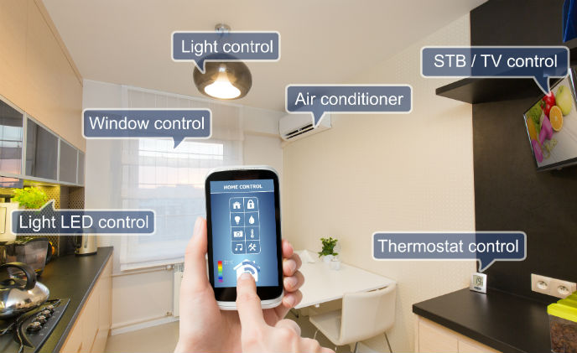
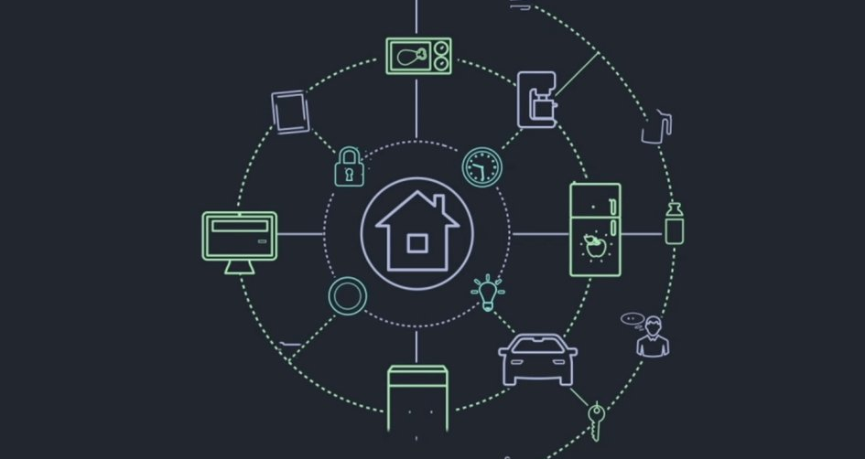
Introduction
A smart home means your home has a smart home system that connects with your appliances to automate specific tasks and is typically remotely controlled.
Smart homes allow you to have greater control of your energy use, all while automating things like adjusting temperature, turning on and off lights, opening and closing window treatments, and adjusting irrigation based on the weather

Slide 5

Our smart home

Slide 6
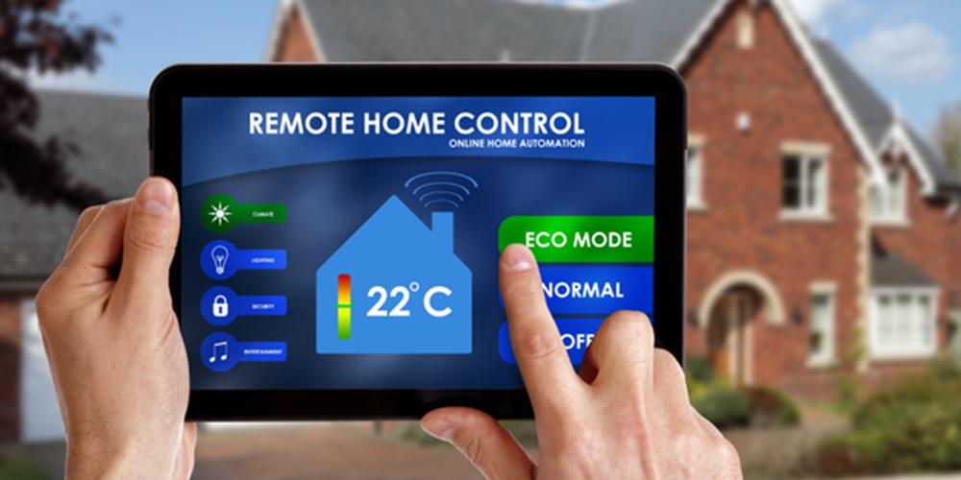
Main points
Controlling temperature
Turning on and off the lights
Opening and closing doors
Providing insights into energy use
Control the leakage of water
Control the leakage of gas

Slide 7
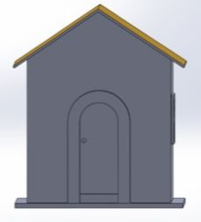
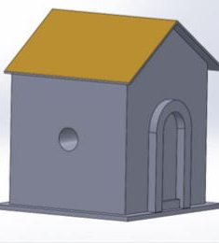
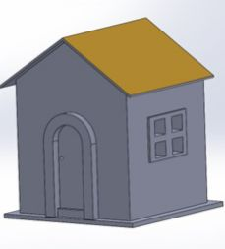
Project design

Slide 8
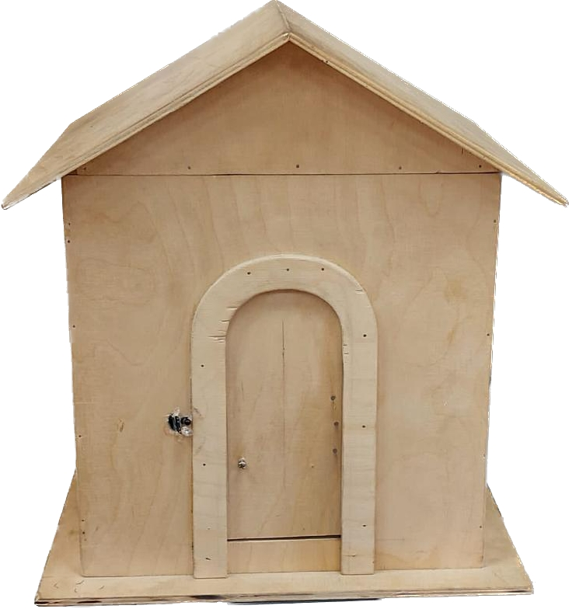
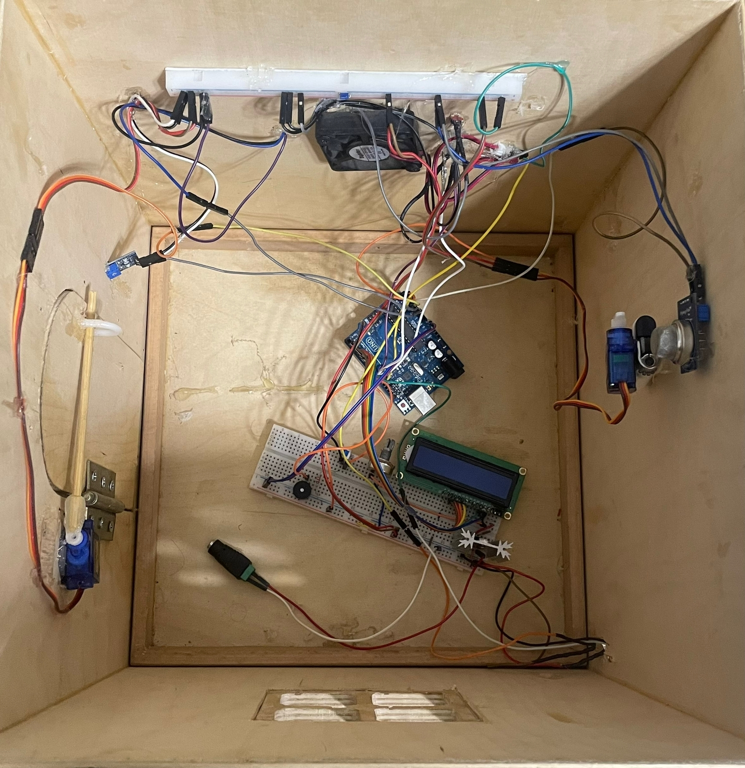
Project Design

Slide 9
Components
Electrical components
Arduino UNO | Temperature sensor
LDR | Transistors
Air quality sensor | Wires
LCD | Battery
Heat sink | Resistances

Slide 10
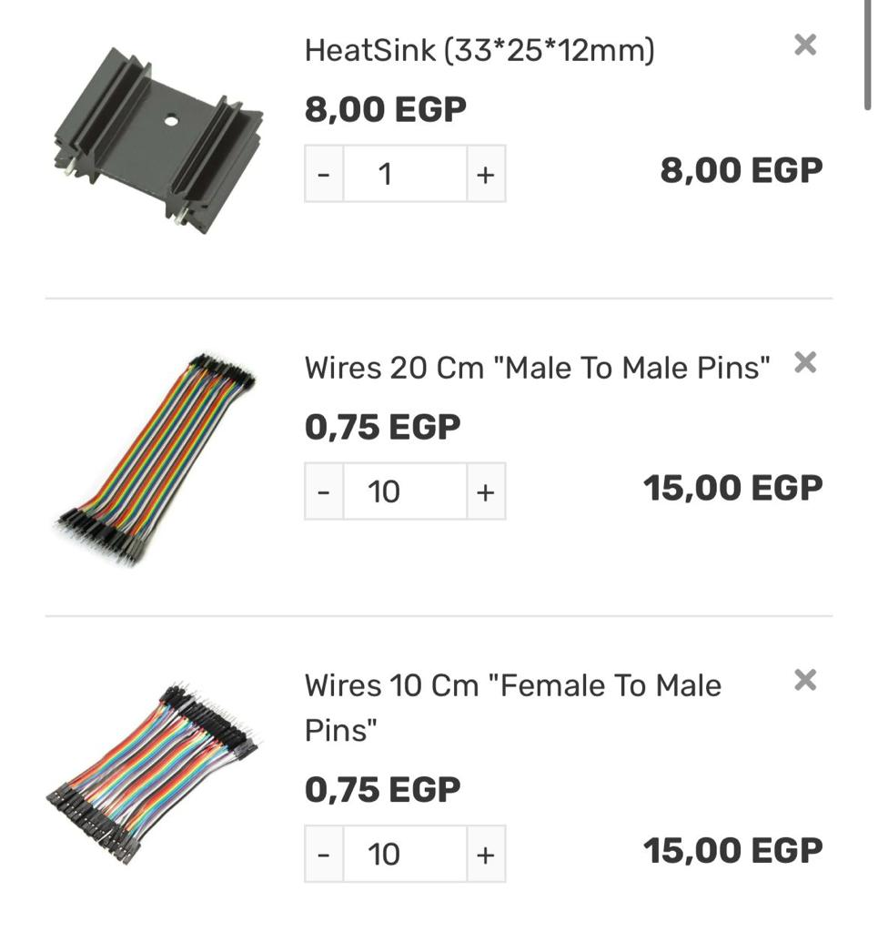
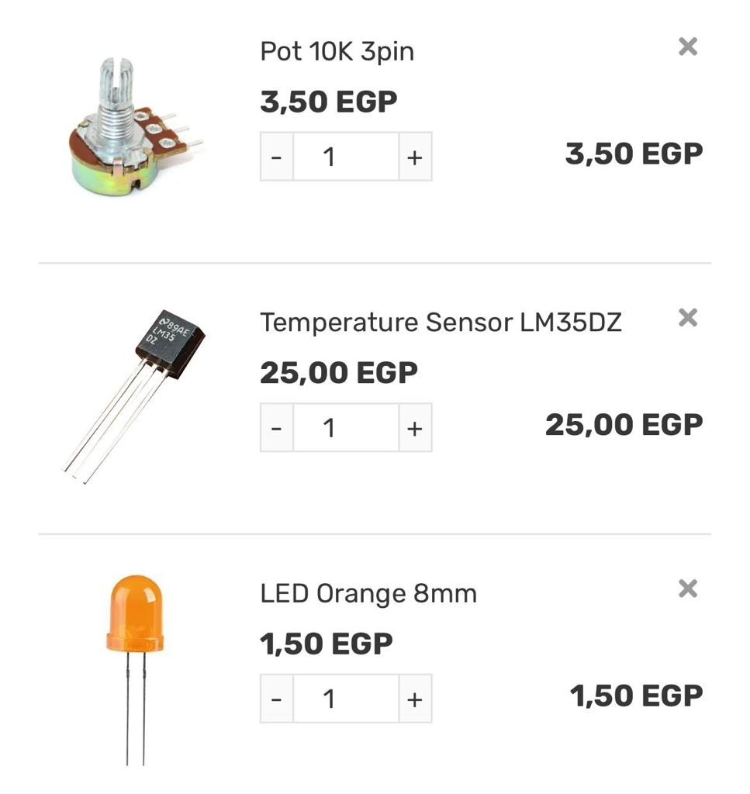
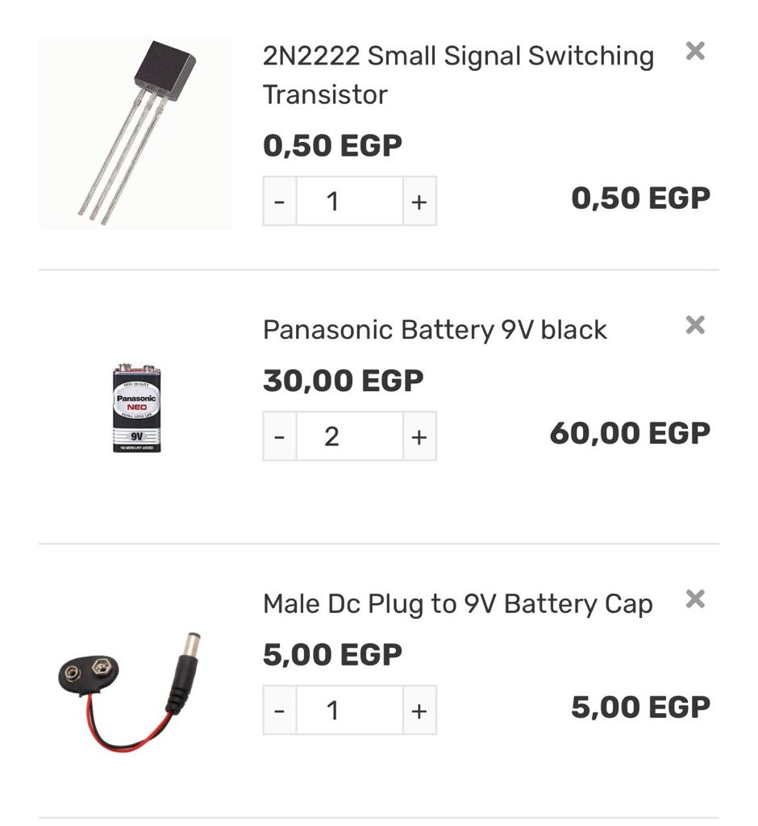
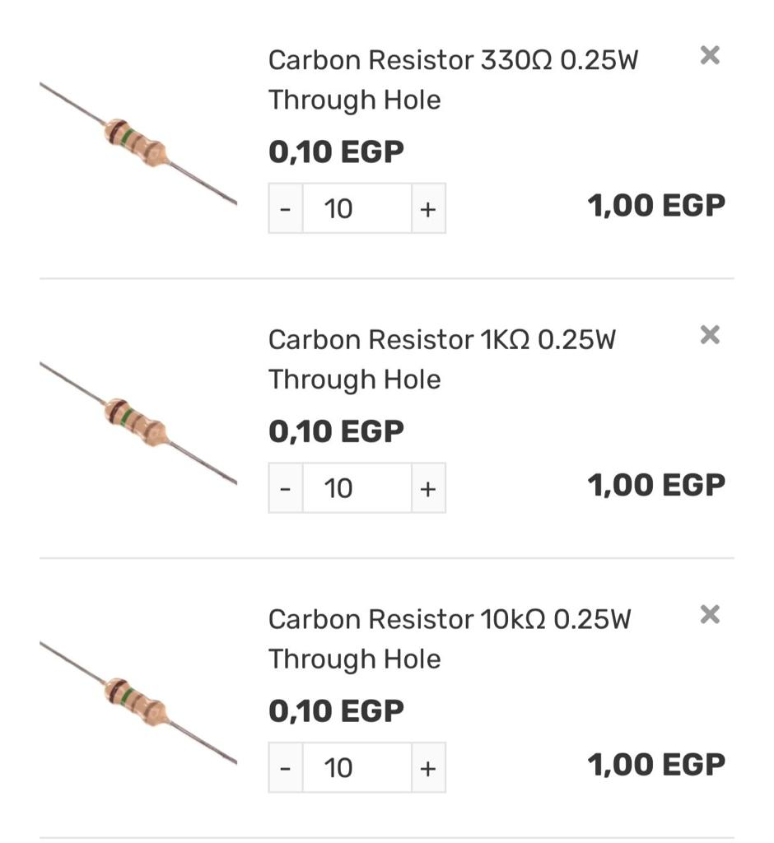
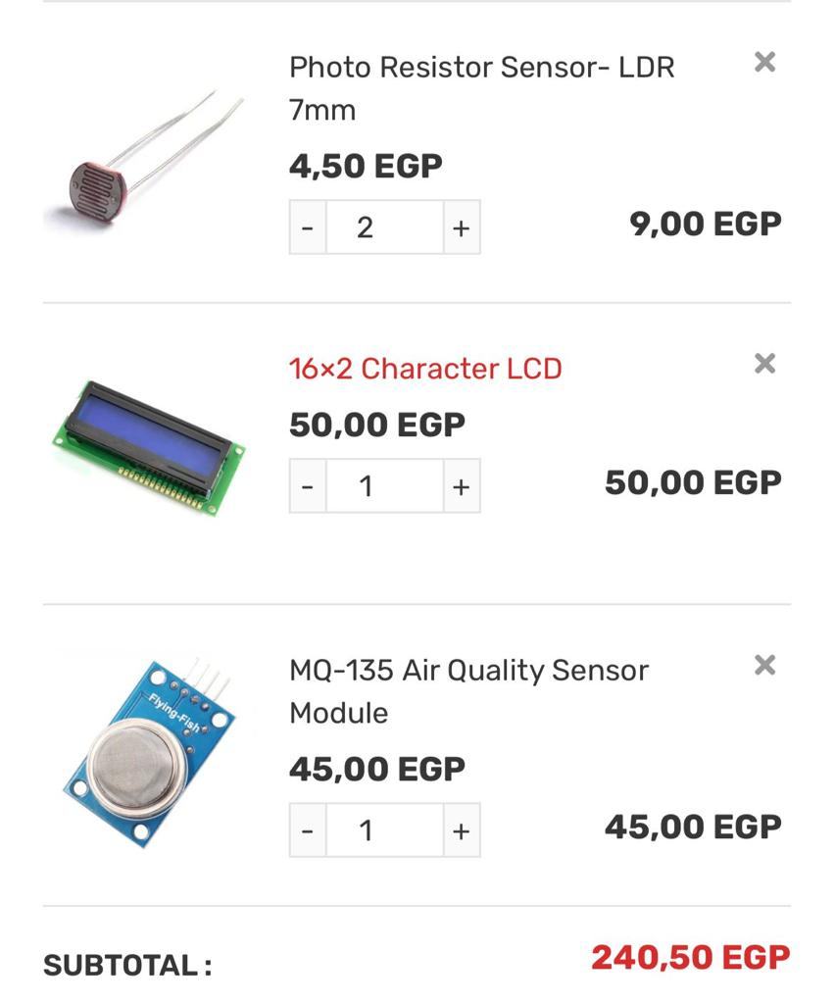
The Cost

Slide 11
The Cost
2 Arduino each one 400 L.E. Water sensor 65 L.E.
2 Motors servo each one 65 L.E. Variable resistance 5 L.E.
Buzzer 5 L.E. 2 Relays 15 L.E.
Fan 60 L.E. LED 5 L.E.
Lighter 10 L.E. LDR 5 L.E.
Electric motor solenoid 100 L.E. IR 35 L.E.
2 LCD each one 65 L.E.

Slide 12
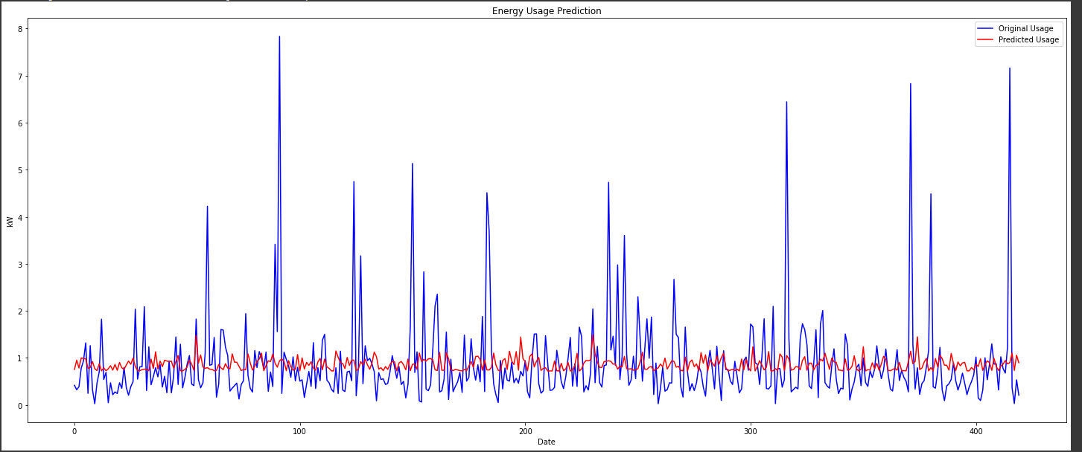
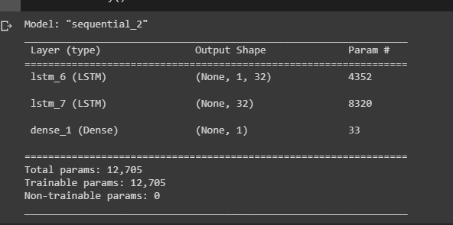
AI model1

Slide 13
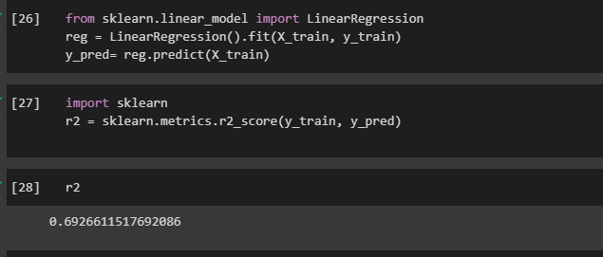
AI model 2

Slide 14
Team Members:
Omnia Yasser
Kerols Rimon
Osama Ayman
Sarah Ibrahim
Youssry Etman
GitHub link: https://github.com/Omniayasser/Smart-Home

Slide 15




Thank you

